Slide 1
Artificial Intelligence
Error-driven classification – Perceptron
Notes:
Slides and exercises are inspired by Russell & Norvig AI Book, Stanford’s AI course and from Berkeley’s AI course

Slide 2
Errors
Problem: there’s still spam in your inbox
Need more features – words aren’t enough!
Have you emailed the sender before?
Have 1M other people just gotten the same email?
Is the sending information consistent?
Is the email in ALL CAPS?
Do inline URLs point where they say they point?
Does the email address you by (your) name?
Naïve Bayes models can incorporate a variety of features, but tend to do best in homogeneous cases (e.g. all features are word occurrences)

Slide 3
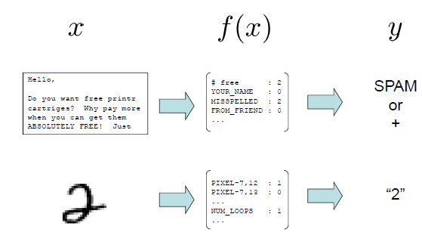
Feature vectors
HAM

Slide 4
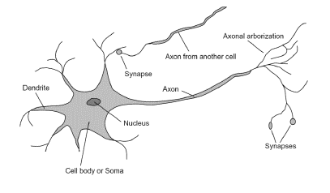
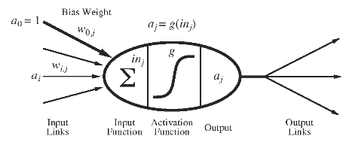
Analogy with biological neurons
Inputs are feature values
Each feature has a weight
g(sum) is the activation
Activation has some threshold:
Greater than threshold, output +1
Smaller than threshold, output ‐1

Slide 5
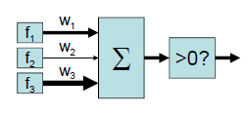
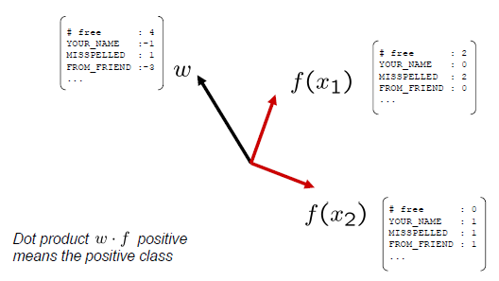
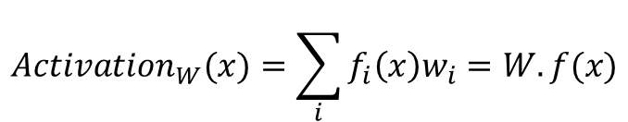
Linear classification
Binary classification: compare features to a weight vector
$$Activation_{W}(x)=\sum_{i}{f_{i}\left(x\right)w_{i}=W.f(x)}$$
In the space of feature vectors
▪ Examples are points
▪ Any weight vector is a hyperplane
▪ One side corresponds to Y=+1
▪ Other corresponds to Y=‐1

Slide 6
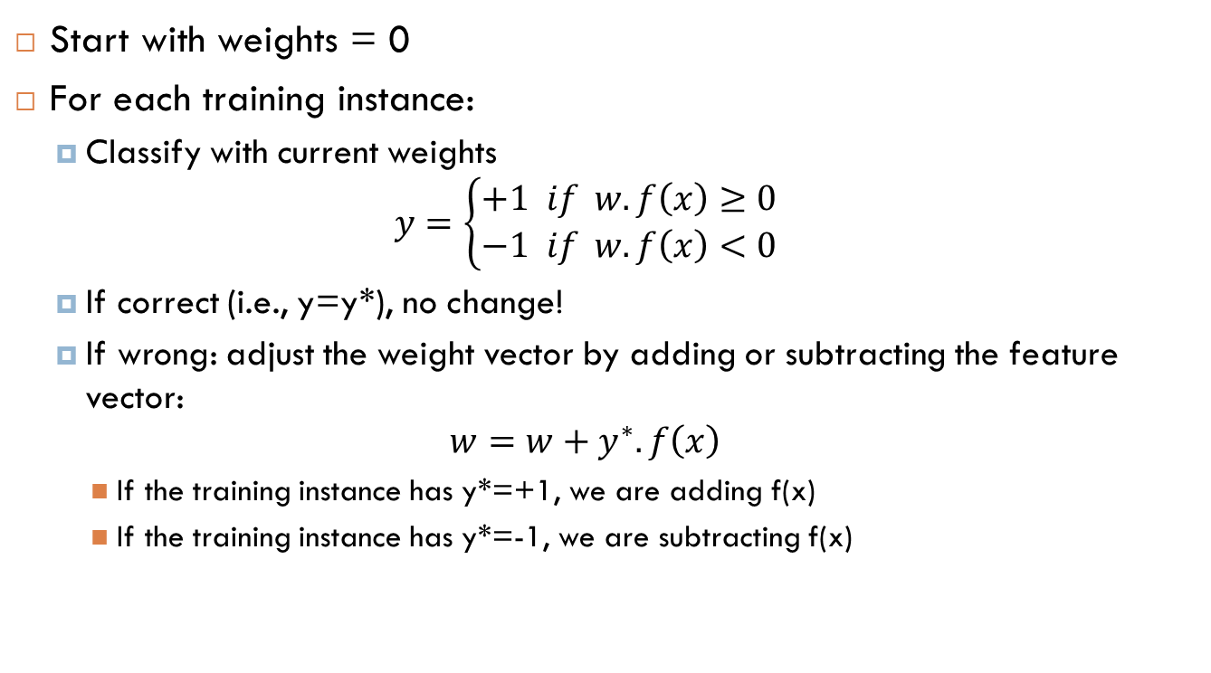
Binary perceptron algorithm
Start with weights = 0
For each training instance:
Classify with current weights
$$y=\left\{\begin{matrix}+1 if w.f\left(x\right)≥0 \\ −1 if w.f\left(x\right)<0\end{matrix}\right.$$
If correct (i.e., y=y*), no change!
If wrong: adjust the weight vector by adding or subtracting the feature vector:
$$w=w+y^{∗}.f\left(x\right)$$
If the training instance has y*=+1, we are adding f(x)
If the training instance has y*=-1, we are subtracting f(x)

Slide 7
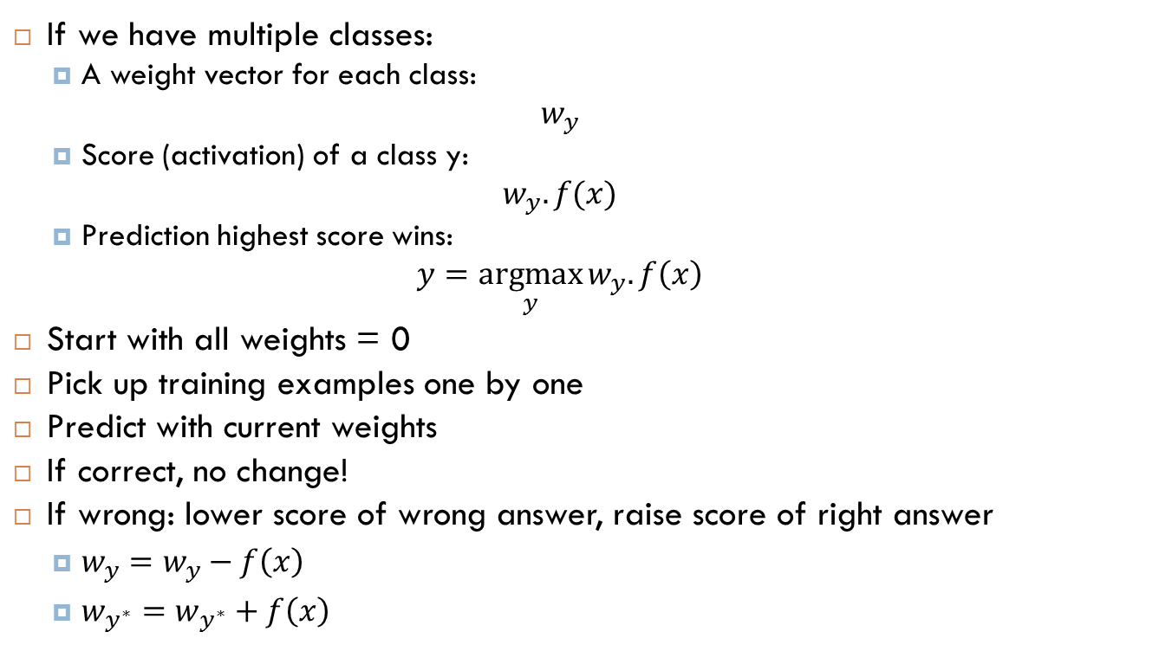
Multi-class perceptron algorithm
If we have multiple classes:
A weight vector for each class:
$$w_{y}$$
Score (activation) of a class y:
$$w_{y}.f(x)$$
Prediction highest score wins:
$$y=\underset{y}{argmax}{w_{y}.f\left(x\right)}$$
Start with all weights = 0
Pick up training examples one by one
Predict with current weights
If correct, no change!
If wrong: lower score of wrong answer, raise score of right answer
$w_{y}=w_{y}−f\left(x\right)$
$w_{y^{∗}}=w_{y^{∗}}+f\left(x\right)$

Slide 8
Properties of perceptron
Separable case
Non-separable case
Separability: true if some parameters get the training set perfectly correct
Convergence: if the training set is separable, perceptron will eventually converge (binary case)

Slide 9
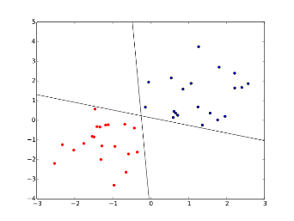
Limitations of the perceptron algorithm
Noise: if the data isn’t separable, weights might thrash
Averaging weight vectors over time can help (averaged perceptron)
Mediocre generalization: finds a “barely” separating solution
Overtraining: test / held‐out
accuracy usually rises, then falls
Overtraining is a kind of overfitting

Slide 10
Implementation
https://www.kaggle.com/code/nassar/perceptron-exercise

Slide 11
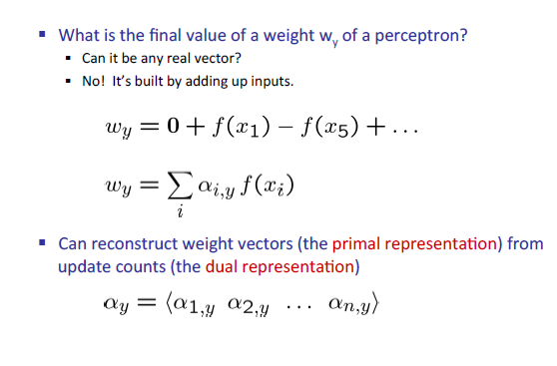
Perceptron dual form

Slide 12
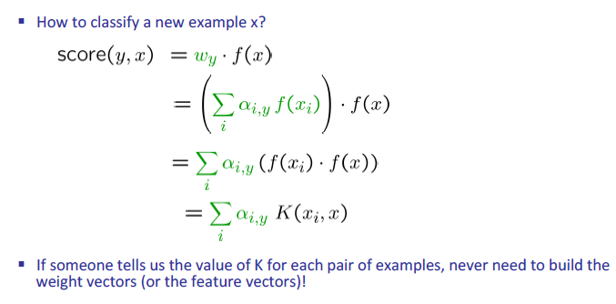
Kernelization

Slide 13
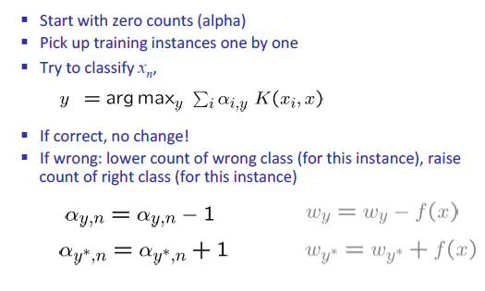



Dual perceptron algorithm
$x_{n})$
$x_{n})$
$x_{n})$

Slide 14
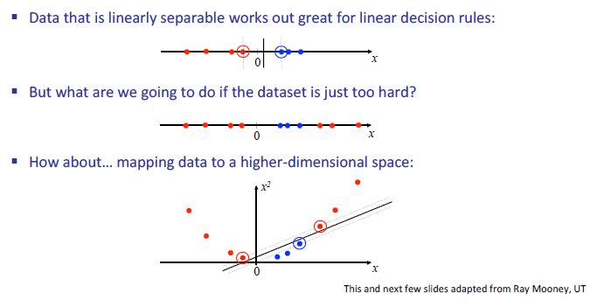
Kernel trick
“Kernel trick”: we can substitute the dot product by another similarity function!
The similarity function can behave as if we are adding new dimensions to the data!

Slide 15
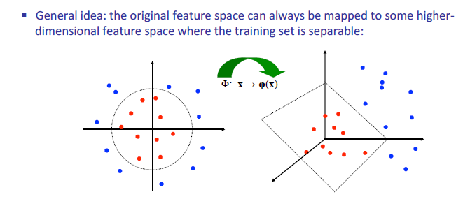
Non-linear separators

Slide 16

Example of kernels
Quadratic kernel
New dimensions added:
Radial Basis Function (RBF) Kernel ( infinity of dimensions )
Infinity of dimensions added!
Notes:
Since the value of the RBF kernel decreases with distance and ranges between zero (in the limit) and one (when x = x'), it has a ready interpretation as a similarity measure.

Slide 17
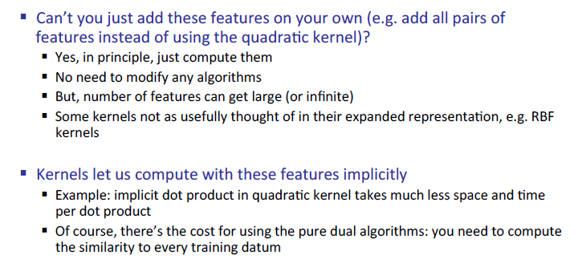
Why kernels?

Slide 18
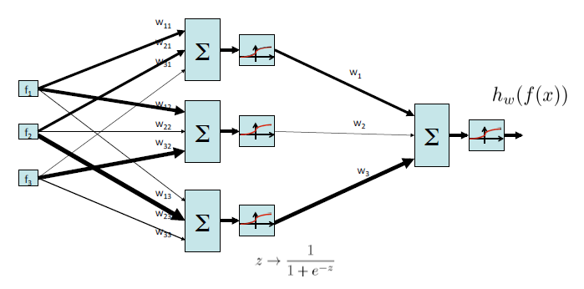
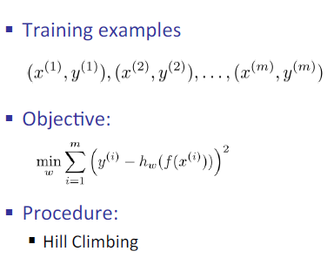
What is a neural network?
By small adjustments to the weights

Slide 19
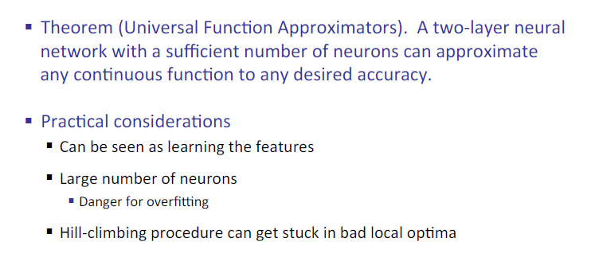
Neural network properties

